Slide 1

SIM UOW
CSCI 218
Group 18
Bank Marketing Machine Learning

Slide 2
Github Link:
https://github.com/victorjongsoon/CSCI218_Group18_Bank_Marketing
Notes:
Hi I am Huiting from group 18, today my team and I will be presenting on Banki Marketing Machine Learning topic for this group project

Slide 3
Meet our team
Victor Jong Soon Peng
Liu HuiTing
Lee Ying Hui
8769229
8083149
8335187
Joanne Goh Yi Xuan
Patrick Tan Shoong Chin
Lai Jun Xian Bryan
8038946
8083162
8039331
Notes:
These are my group members

Slide 4
Team Contribution
Team Members | Contribution Percentage | Key Task
Victor Jong Soon Peng | 100% | Data Preprocessing + Literature Review
Liu Hui Ting | 100% | Logistic Regression + Literature Review + Metrics
Lee Ying Hui | 100% | Logistic Regression + Manual Data Testing + Metrics
Joanne Goh Yi Xuan | 100% | EDA + Feature Engineering
Patrick Tan Shoong Chin | 100% | XGBoost Model + Introduction
Lai Jun Xian Bryan | 100% | Random Forest Model + Literature Review
Notes:
And our contributions

Slide 5
Table of contents
01
04
02
05
03
06
Introduction
Model Training
Literature Review
Training Results
EDA & Data Pre-Processing
Conclusion
Notes:
This is what we will be sharing in this presentation.

Slide 6

01
Introduction

Slide 7
Introduction
A common marketing approach for bank to attract customers for term deposition is through phone calls. However, reaching out to a large number of clients can be time consuming and inefficient without a target strategy. In this project, we will be identifying patterns that indicates which clients are more likely to make subscribe to a term deposit.
Aim of this project:
Improve the efficiency of marketing campaigns.
Reduce unnecessary contact with uninterested clients.
Increase the success rate of term deposit subscriptions.
This study is important because a well-trained model can help banks optimise their marketing strategies and minimises cost. Additionally, our project will demonstrate how Machine Learning can be applied to real world scenario making marketing efforts more data driven and effective.
Notes:
Typically, banks rely on phone calls to reach potential customers. However, making calls without a targeted approach can be time-consuming and inefficient. Our project focuses on identifying patterns that indicate which clients are more likely to subscribe to a term deposit.
The key objectives of this project are:
To improve the efficiency of marketing campaigns.
To reduce unnecessary contact with uninterested clients.
To increase the success rate of term deposit subscriptions.
This study is important because a well-trained model can help banks refine their marketing strategies, reducing costs while improving effectiveness.
Moreover, this project highlights how Machine Learning can be applied to real-world scenarios, making marketing efforts more data-driven and impactful.

Slide 8
02
Literature
Review

Slide 9
Literature Review 1
A recent study titled "Bank Loan Prediction Using Machine Learning Techniques" by Haque and Hassan (2024), their research utilises a dataset of 148,670 instances and 37 attributes. The models they used and its accuracy obtained are as follow:
AdaBoosting - 99.99%
Random Forest Classifier - 99.98%,
Decision Tree - 99.93%,
Support Vector Machine (SVM) - 99.87%
Gaussian Naive Bayes - 77.10%
Data Pre-processing steps:
Missing value removal
Feature selection (reduced attributes to 34, significant to capture key relationship)
Encoding (non-numerical information were converted into a numerical format)
Exploratory Data Analysis (EDA)
Though this study focuses on loan approval predictions, its methodologies and findings are relevant to our project on forecasting term deposit subscriptions. Both scenarios involve binary classification and rely on customer demographics and financial data. However, considering potential drawbacks, the high accuracy reported may indicate overfitting, especially if the model captures noise together with the underlying patterns.
Notes:
Let’s now look at a recent study titled 'Bank Loan Prediction Using Machine Learning Techniques' by Haque and Hassan publish in 2024.
In their study, they used a large dataset with 148 thousand instances and 37 attributes.
These are the machine learning algorithm they have used and their accuracy.
AdaBoosting: 99.99%
Random Forest Classifier: 99.98%
Decision Tree: 99.93%
SVM: 99.87%
Gaussian Naive Bayes: 77.10%
The data pre-processing steps included:
Removing missing values,
Selecting significant features (they reduced attributes to 34 that captured the key relationships),
Encoding non-numerical data into a numerical format,
And performing EDA.
Although the focus of this study is on loan approval predictions, its methodology and findings are quite relevant to our project on forecasting term deposit subscriptions.
Both involve binary classification, and rely on customer demographics and financial data.
However, we should be cautious when interpreting their results. Because the high accuracy, especially for models like AdaBoosting and Random Forest, could be a sign of overfitting.
Which means the model is capturing not just the underlying patterns, but memorising the dataset.

Slide 10
Literature Review 1
Advantages and Drawbacks
Advantages:
Proper pre-processing steps taken.
Missing value removal
Feature Selection - Keep only useful data for training which improves model efficiency while reducing computation cost
Missing value removal
EDA
Drawbacks:
Risk of overfitting - AdaBoosting achieved high accuracy (99.99%) but it raises concern about overfitting
Notes:
Advantage:
Proper pre-processing steps provides a good foundation for the model training afterwards.
A key highlight is feature Selection, where researcher reduced attributes to 34, to ensure only the most relevant features contribute to predictions.
Disadvantage:
Risk of Overfitting – Extremely high accuracy such as Adaboosting has a 99.99% accuracy, suggests the models may be overfitting, meaning it memorises the training data instead of learning

Slide 11
Literature Review 2
Another study titled "Applying Machine Learning to the Development of Prediction Models for Bank Deposit Subscription" by Sipu Hou et al. (2022), their research utilises a dataset of 45,211 instances and 20 attributes. The models they used and its accuracy obtained are as follow:
Random Forest - 91.89%
Decision Tree - 91.76%
Support Vector Machine (SVM) - 91.72%
Neural Network - 88.76%
Naïve Bayes - 86.54%
This study only focused on handling missing data for pre-processing, it outlines three common mechanisms for missing data:
Missing Completely at Random (MCAR) – Data is missing randomly without relation to other variables.
Missing at Random (MAR) – Missing data depends on observed variables.
Missing Not at Random (MNAR) – Missing data depends on unknown factors, potentially with bias
This study used a unique approach to handling missing values. For categorical data like the “default” attribute, where “yes” observations were very less, authors kept “unknown” as a separate category, while other variables with “unknown” values were removed.
Notes:
Another study titled 'Applying Machine Learning to the Development of Prediction Models for Bank Deposit Subscription' by Sipu Hou in 2022 has the same objective as our current topic.
In this study, the researchers worked with a dataset of 45 thousand instances and 20 attributes.
These are the machine learning algorithm they have used and their accuracy.
Random Forest: 91.89%
Decision Tree: 91.76%
SVM: 91.72%
Neural Network: 88.76%
Naïve Bayes: 86.54%
The pre-processing phase of this study focused mainly on handling missing data.
They outlined three common mechanisms for missing data:
Missing Completely at Random (MCAR) – Where data is missing without any relation to other variables,
Missing at Random (MAR) – Missing data that depends on observed variables,
Missing Not at Random (MNAR) – Where missing data depends on unknown factors, potentially introducing bias.
They have a unique approach to handle missing values in categorical data, such as their “default” attribute. Since there were very few "yes" observations,
they treated "unknown" as a separate category. For other variables with "unknown" values, they simply removed those records except for “default”.

Slide 12
Literature Review 2
Advantages and Drawbacks
Advantages:
Handling Missing Data – Deeper understanding on classifying missing data
Drawbacks:
Limited pre-processing steps - focus only on missing data, may cause over or underfitting as model cannot find meaning patterns
Class imbalance concerns - unequal distribution of class, models may be biased towards the majority class, causing misleading accuracy scores
Notes:
Advantage:
Handling Missing Data – this study has a deeper understanding on classifying missing data and handling techniques which improve data quality and enhance model training
Disadvantage:
Limited Focus on Data Preprocessing – The second study mainly focused on missing data but lacked feature engineering and encoding steps that could improve generalization.
Class Imbalance Concerns – the dataset has unequal class distribution, models may be biased towards the majority class, causing misleading accuracy scores.
So with the observation on these 2 studies, we will carefully work out our implementations to prevent similar issues. Moving on, i will pass the time to joanne to share with you on EDA for our project.

Slide 13
SIM UOW
CSCI 218
Group 18
Bank Marketing Machine Learning
Notes:
Hi I am Huiting from group 18, today my team and I will be presenting on Banki Marketing Machine Learning topic for this group project

Slide 14
03
EDA & Data Pre-Processing

Slide 15
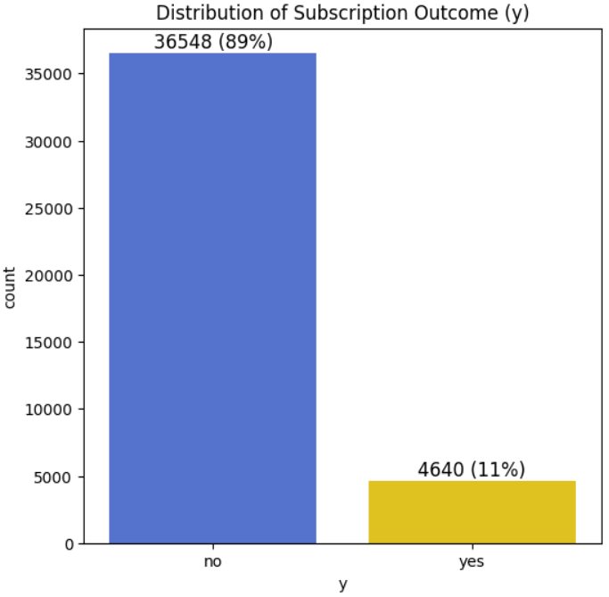
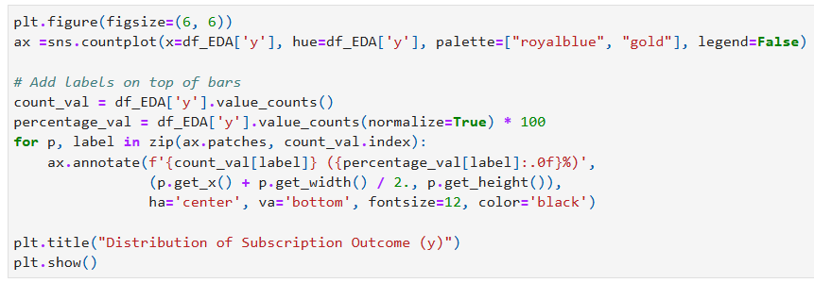
Exploratory Data Analysis (EDA)
Distribution of Subscription Outcome (y)
Observation(s):
Distribution of subscription outcome (y) is imbalanced.

Slide 16
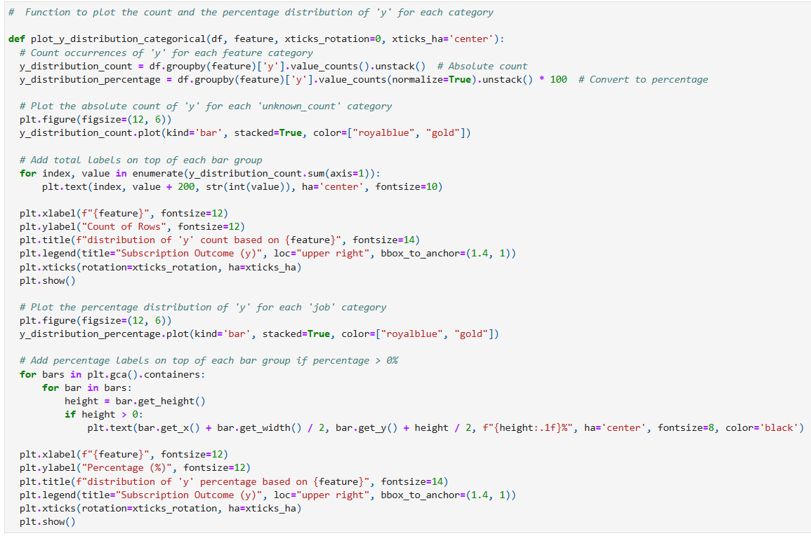
Exploratory Data Analysis (EDA)
Function to Plot Count & Percentage Distribution of ‘y’ for Each Category
Distribution of 'y' Based on Number of "unknown" Values

Slide 17
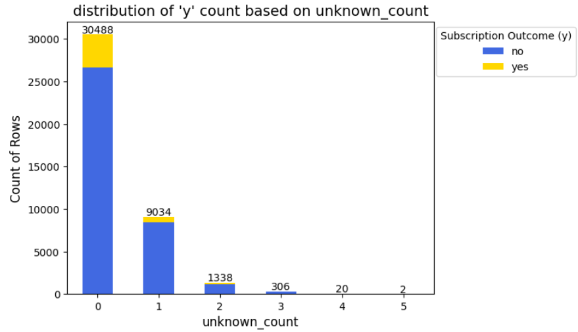
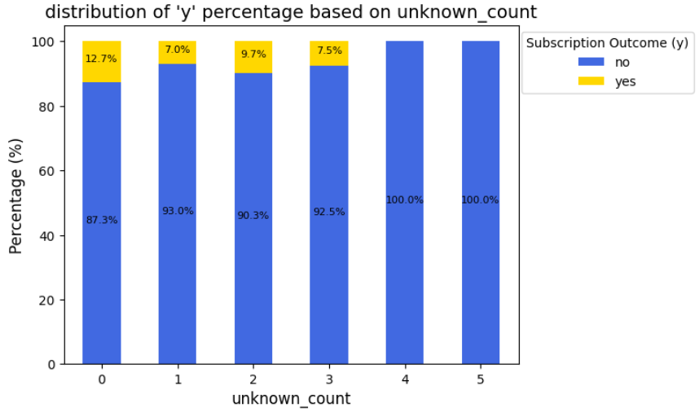
Exploratory Data Analysis (EDA)
Distribution of 'y' Based on Number of "unknown" Values
Observation(s):
Percentage of subscribers (y = yes) varies across different unknown_count values.
The more unknown values a row has, the lower the subscription rate (y = yes).
'unknown' values may itself be an important predictor rather than just missing data.

Slide 18
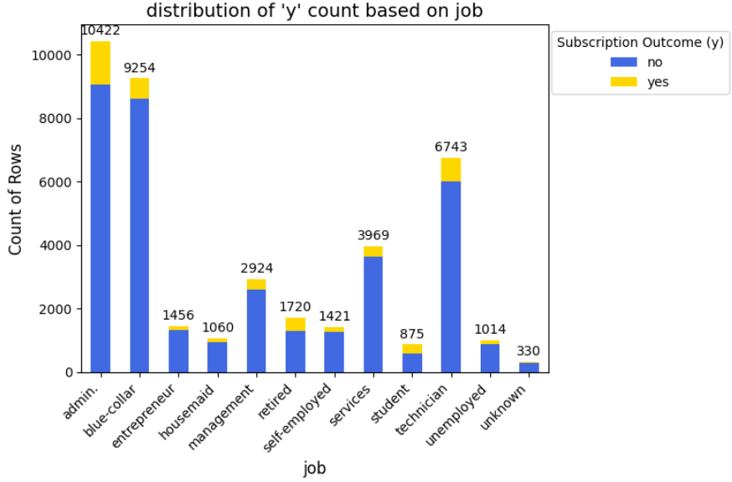
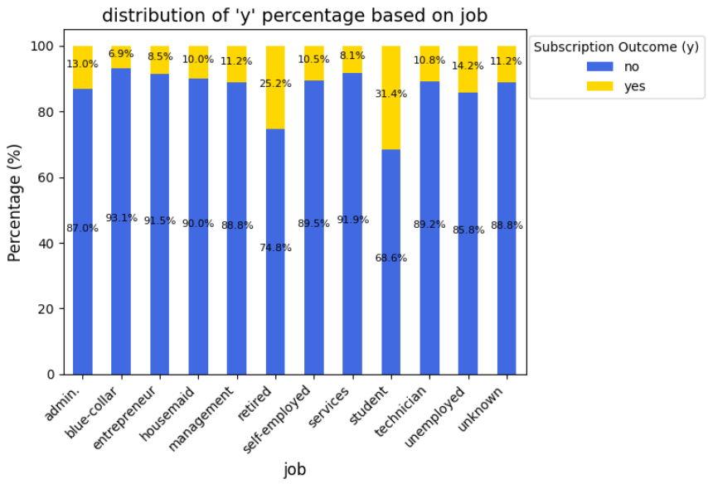
Exploratory Data Analysis (EDA)
Distribution of 'y' Across Different Job
Observation(s):
Subscription outcome, y = yes
Highest percentage (>25%): retired & student Lowest percentage (<7%): blue-collar
Notes:
This could be due to lower risk profile among retirees and students which leads to higher tendency for term deposit subscription.

Slide 19
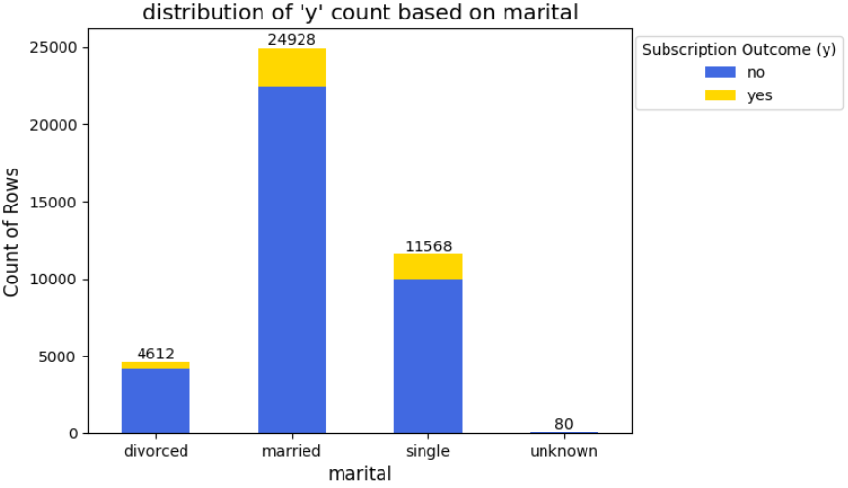
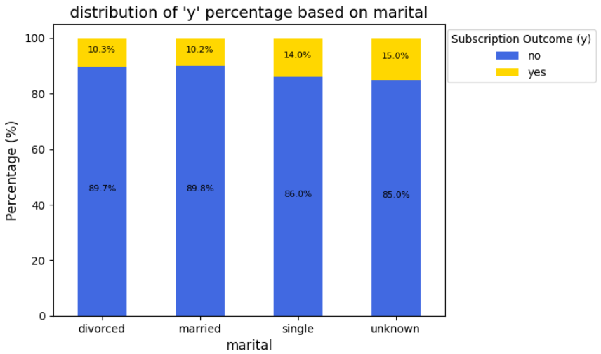
Exploratory Data Analysis (EDA)
Distribution of 'y' Across Different Marital Status
Observation(s):
Subscription outcome, y = yes
Approximately 10%: divorced & married Higher at 15%: single & unknown
Notes:
Marital status seems to have some influence on the likelihood of subscription.

Slide 20
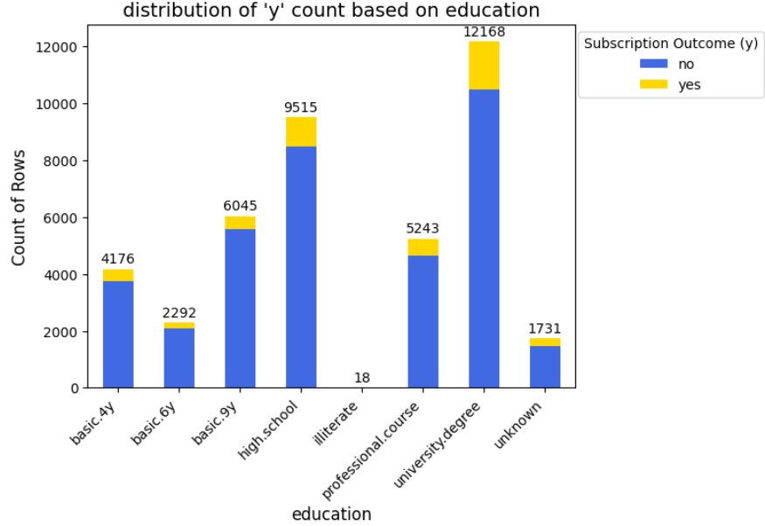
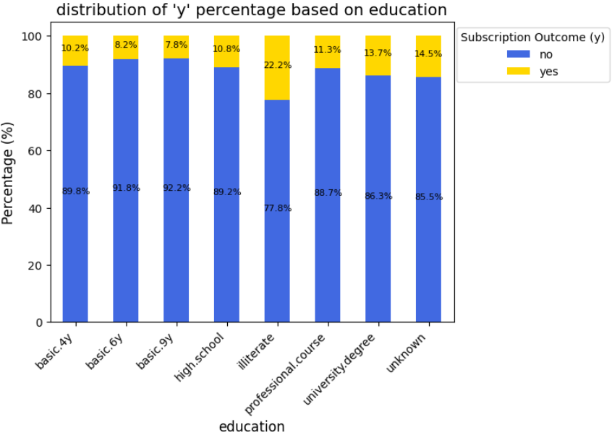
Exploratory Data Analysis (EDA)
Distribution of 'y' Across Different Education
Observation(s):
Subscription outcome, y = yes
Highest percentage (22.2%): illiterate → may not reflect the actual population statistics

Slide 21
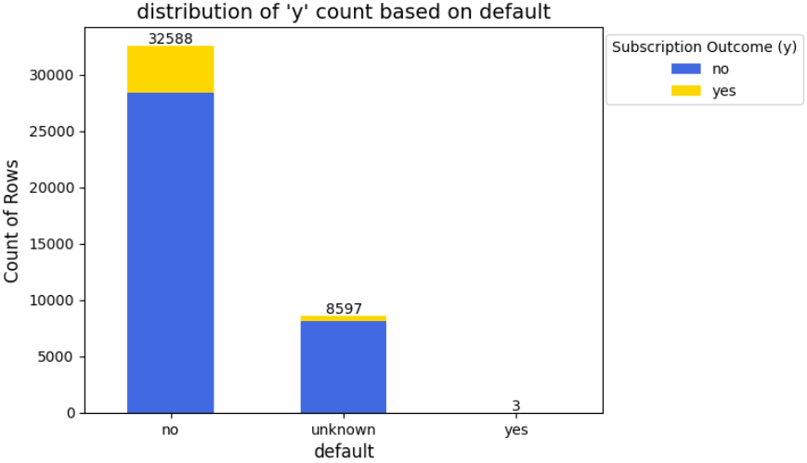
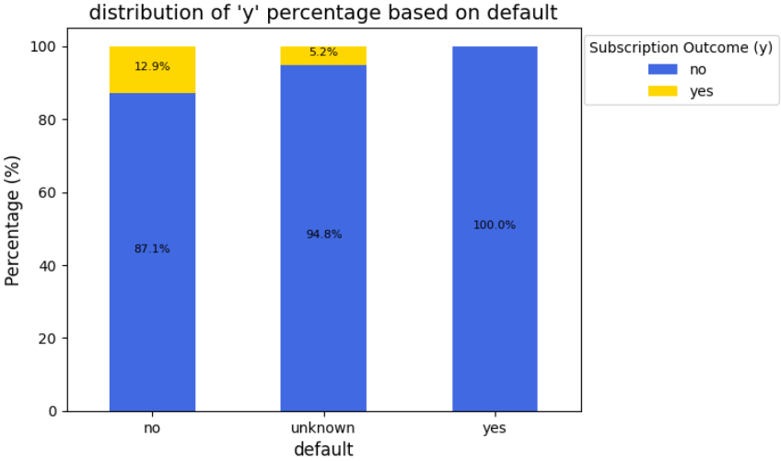
Exploratory Data Analysis (EDA)
Distribution of 'y' Based on Credit Default
Observation(s):
Subscription outcome, y = yes
Have credit line in default (0%) → may not reflect the actual population statistics

Slide 22
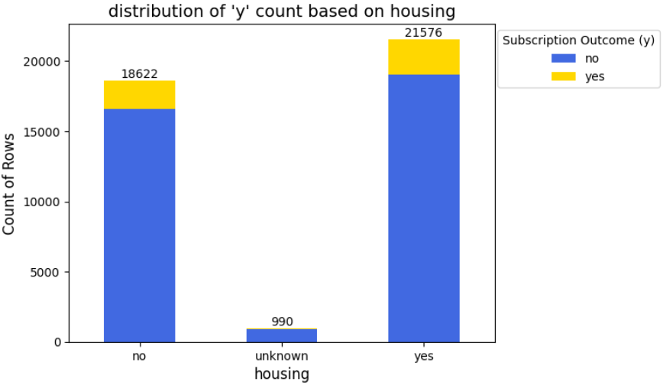
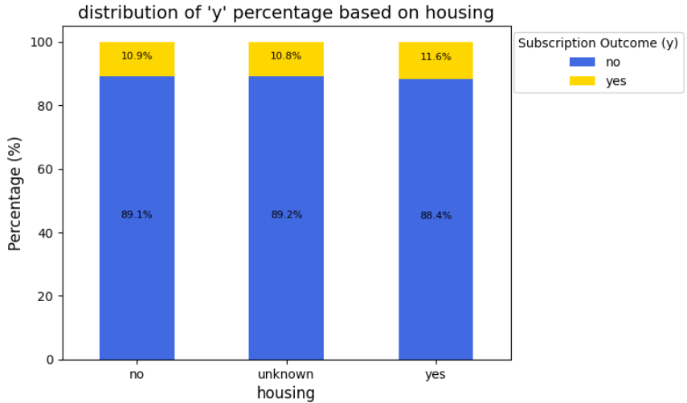
Exploratory Data Analysis (EDA)
Distribution of 'y' Based on Housing Loan
Observation(s):
Subscription outcome, y = yes
Yes/ No housing loan seem to have no significant difference

Slide 23
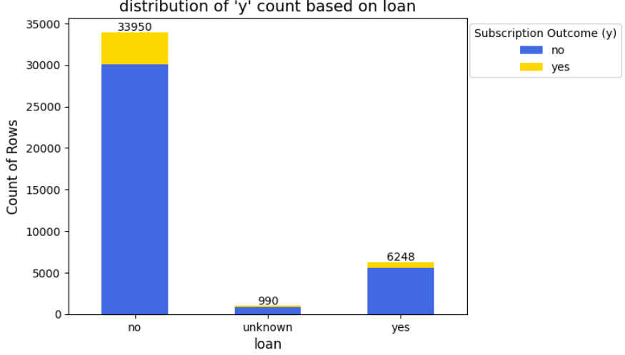
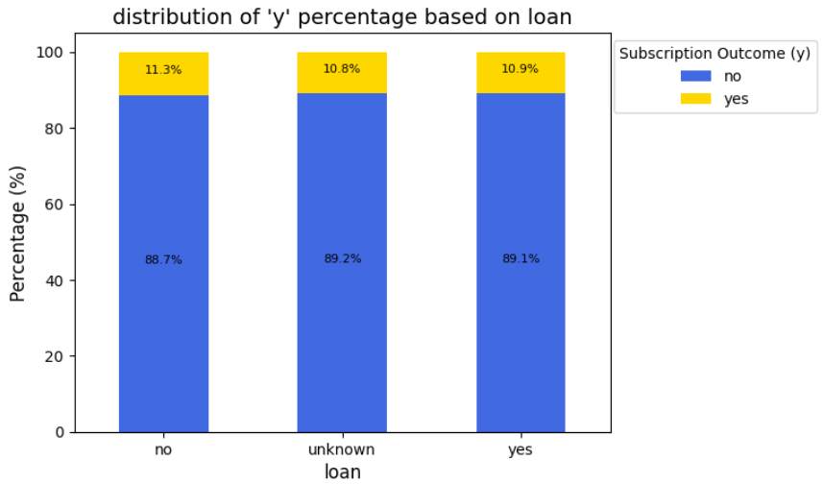
Exploratory Data Analysis (EDA)
Distribution of 'y' Based on Personal Loan
Observation(s):
Subscription outcome, y = yes
Yes/ No personal loan seem to have no significant difference

Slide 24
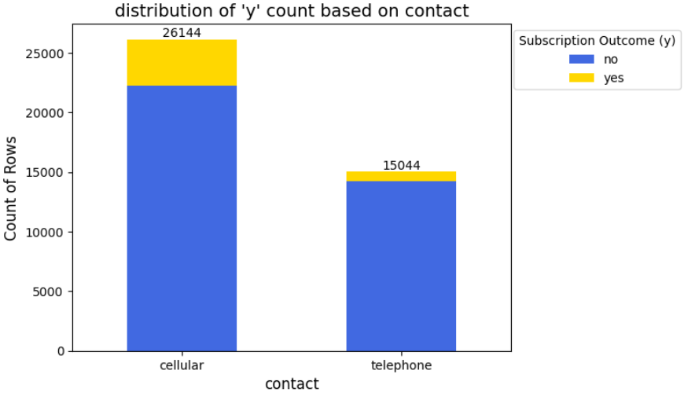
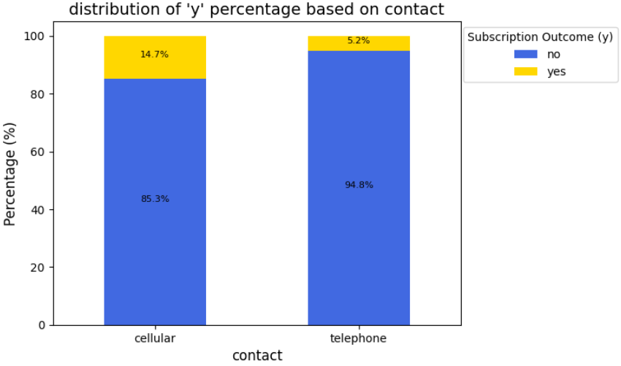
Exploratory Data Analysis (EDA)
Distribution of 'y' Based on Contact Communication Type
Observation(s):
Subscription outcome, y = yes
cellular (14.7 %) > telephone (5.2%) → high influence on the likelihood of subscription

Slide 25
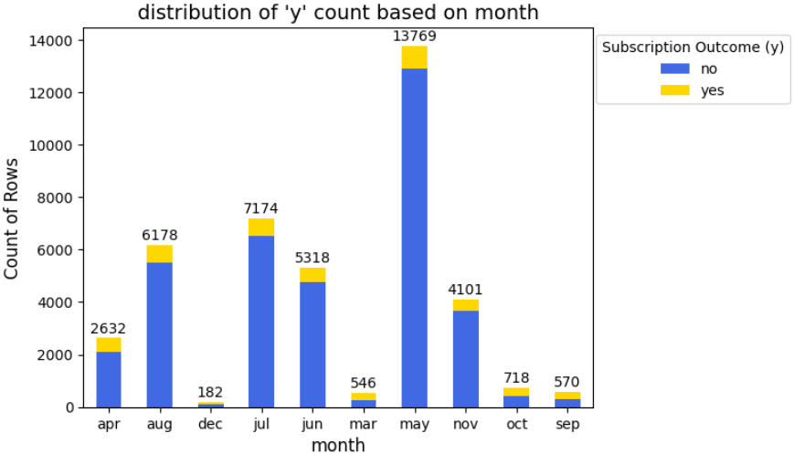
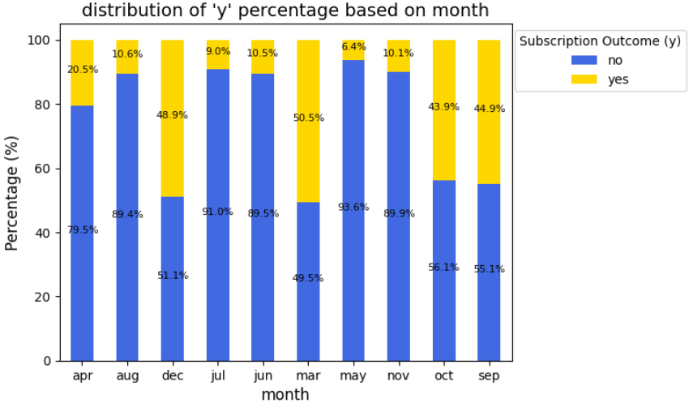
Exploratory Data Analysis (EDA)
Distribution of 'y' Based on Last Contact Month of Year
Observation(s):
Subscription outcome, y = yes
Very high percentage (>43%): Mar, Sep, Oct & Dec → may be influenced by low frequency of calls within a month

Slide 26
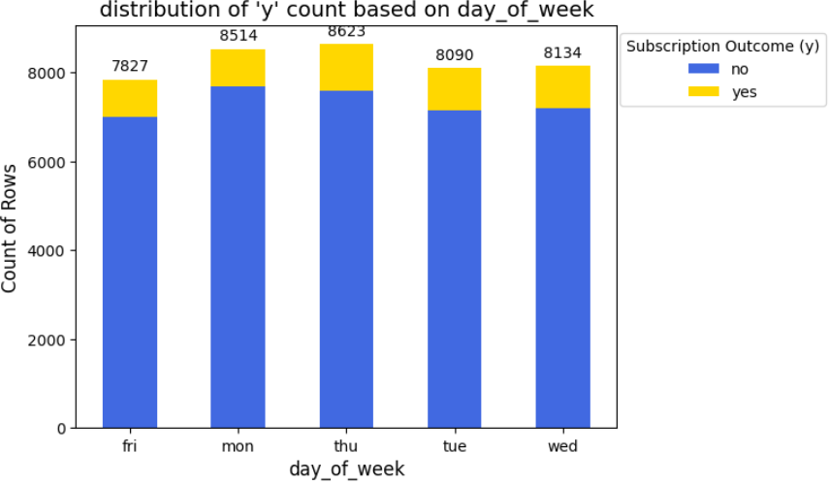
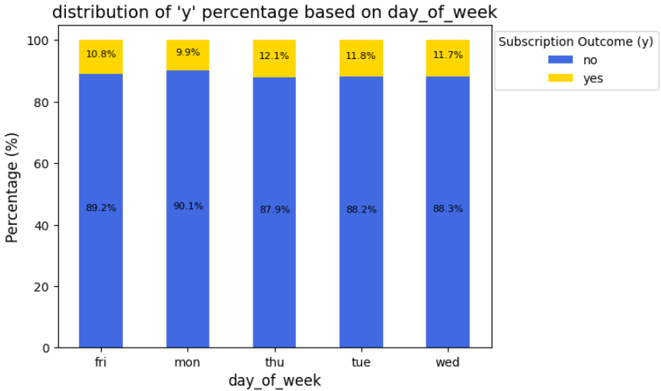
Exploratory Data Analysis (EDA)
Distribution of 'y' Based on Last Contact Day of the Week
Observation(s):
Subscription outcome, y = yes
No significant difference

Slide 27
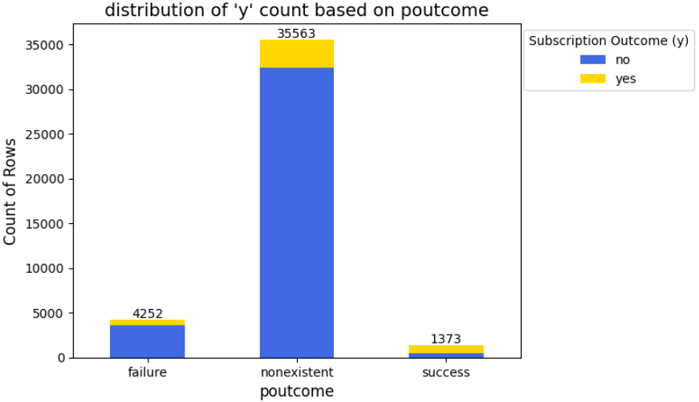
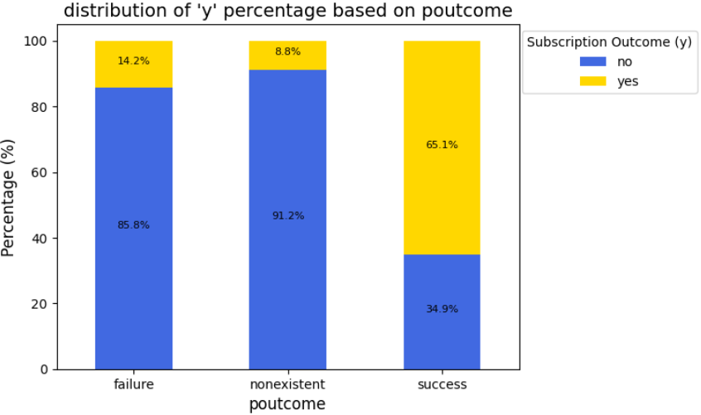
Exploratory Data Analysis (EDA)
Distribution of 'y' Based on Outcome of the Previous Marketing Campaign
Observation(s):
Subscription outcome, y = yes
High influence on the likelihood of subscription

Slide 28
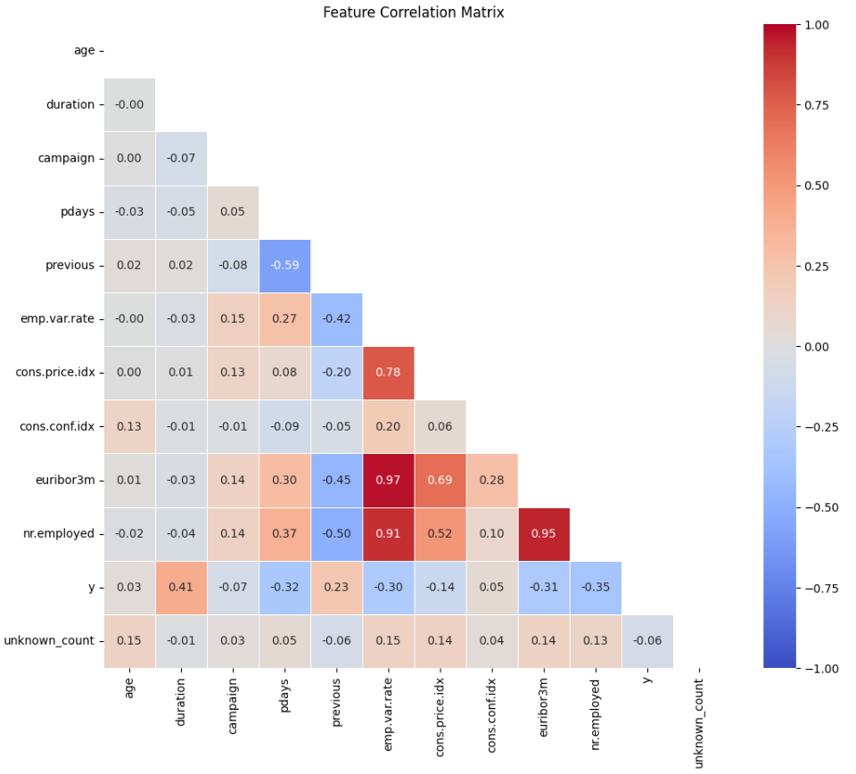
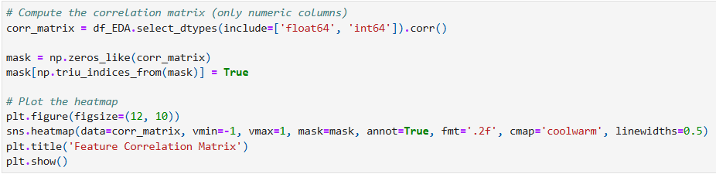
Exploratory Data Analysis (EDA)
Correlation Matrix
Observation(s):
euribor3m and emp.var.rate have high correlation with other features.

Slide 29
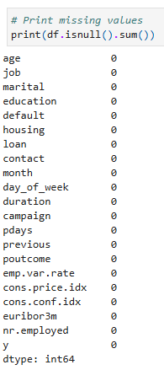
Data Pre-Processing
Handling Missing Values
There is no missing values in the dataset.
Hence, no action required.

Slide 30
Data Pre-Processing
Columns Removed
Columns | Reason for removal
duration | Although duration can increase accuracy but this feature is not useful because it is only known after the call.
euribor3m & emp.var.rate (Logistic Regression) | These two features are highly correlated with other features (nr.employed, cons.price.idx). As a result, it will cause multicollinearity in Logistic Regression.
Notes:
Multicollinearity occurs when two or more independent variables in a dataset are highly correlated. This means they provide redundant information, making it difficult for the model, especially Logistic Regression, to determine which variable is actually influencing the target outcome. This can lead to unstable coefficients, reduced interpretability, and overfitting.

Slide 31
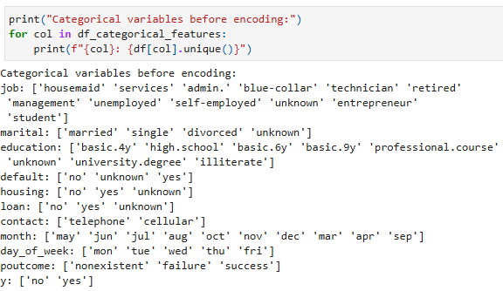
Data Pre-Processing
Encoding categorical features through one hot encoding (Before)

Slide 32
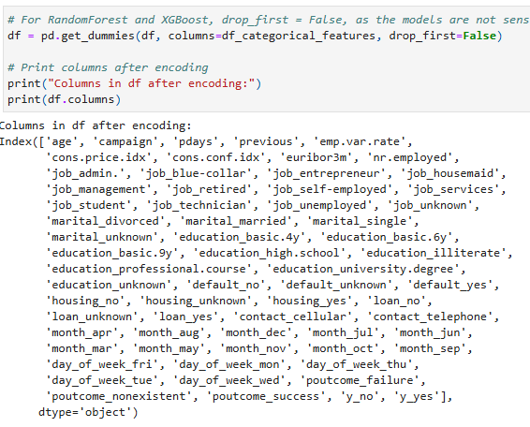
Data Pre-Processing
Encoding categorical features through one hot encoding (After)

Slide 33
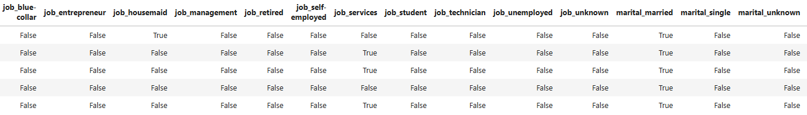
Data Pre-Processing
Encoding categorical features through one hot encoding (After)
Machine learning algorithms such as linear regression, decision tree and random forest are designed to work with numerical data. Hence, we have decided to convert them into binary (e.g., 0 or 1 / true or false).

Slide 34
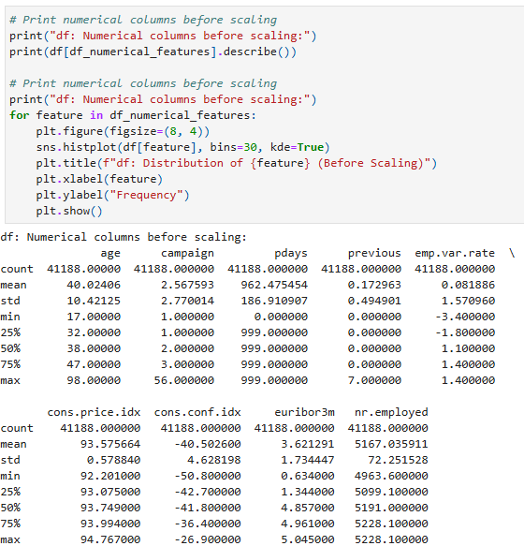
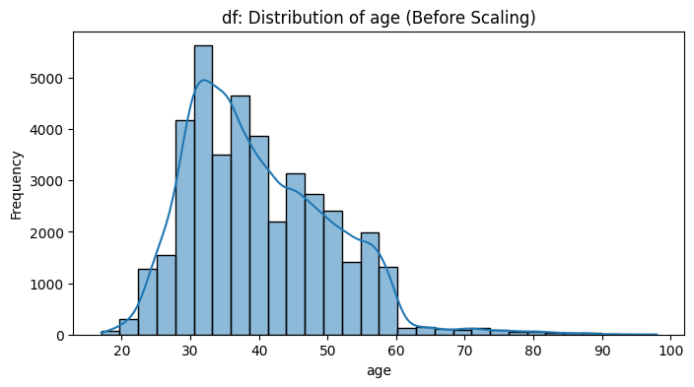
Data Pre-Processing
Feature scaling on continuous numerical features (Before)

Slide 35
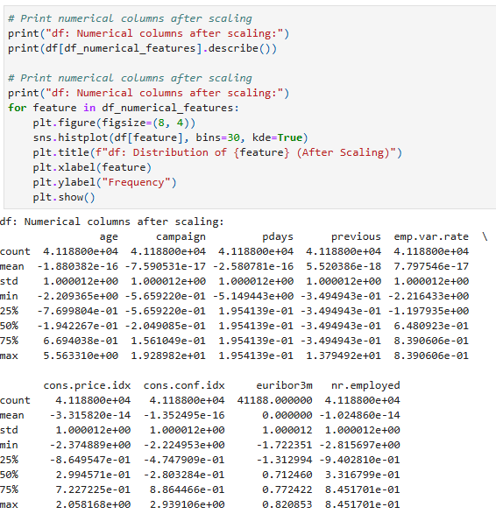
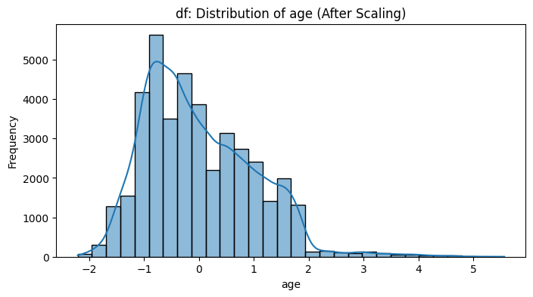
Data Pre-Processing
Feature scaling on continuous numerical features (After)

Slide 36
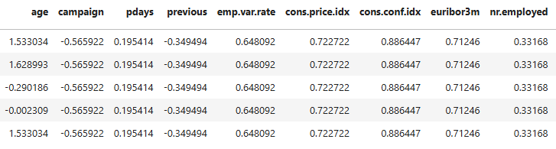
Data Pre-Processing
Feature scaling on continuous numerical features (After)
Without scaling, features with larger ranges can dominate the model, skewing results and giving them false influence compared to features with smaller scales. Bringing all features to similar scale will ensure that all features contributes proportionally to the model.

Slide 37
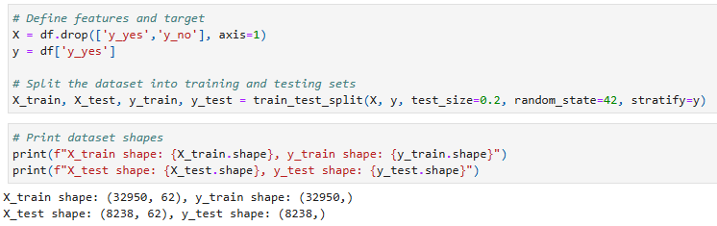
Data Pre-Processing
Train-Test split
Split Ratio: 80% training data, 20% testing data.

Slide 38
04
Model Training

Slide 39
Models for Training and Fine Tuning
1
2
3
Logistics Regression
Random Forest
XGBoost Classifier

Slide 40
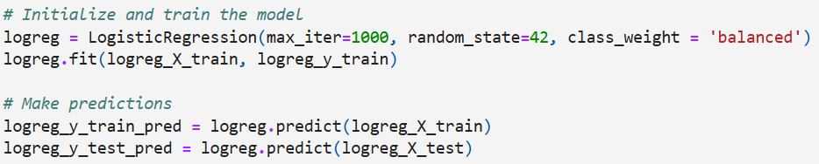
Logistic Regression
Logistic Regression is an ideal starting model for predicting term deposit subscriptions due to its simplicity, interpretability, efficiency, and ability to handle imbalanced data. It allows banks to understand which customer characteristics lead to a successful campaign and optimize their marketing strategies accordingly.
Implementation:

Slide 41
Why Logistic Regression?
Baseline Model
Logistic Regression is often used as a strong baseline model before trying more complex models like Random Forest or XGBoost.
It provides a quick and interpretable starting point for classification tasks.
Interpretability
Unlike black-box models (e.g., deep learning), logistic regression offers clear coefficient values that explain how each feature affects the probability of subscription.
We can easily interpret which factors (e.g., job type, call duration, number of previous contacts) increase or decrease the likelihood of a client subscribing.
Efficiency and Scalability
Logistic Regression is computationally efficient, especially for large datasets, compared to tree-based or deep-learning models.
It runs quickly and can scale well when adding more features.
Handling of High-Dimensional Data
With feature selection and regularization (L1 for sparsity, L2 for smoothness), logistic regression remains effective even when dealing with many features (e.g., customer demographics, banking history, past campaign interactions).
Handling Imbalanced Data
Many real-world datasets (including marketing campaigns) have imbalanced classes (e.g., 90% "No" vs. 10% "Yes").
By using class_weight='balanced', logistic regression adjusts the learning process to avoid biasing toward the majority class, improving recall for minority cases.

Slide 42
Hyperparameter Tuning for Logistic Regression
C (Regularization Strength)
Definition: Controls the strength of regularization.
Effect: Smaller C = stronger regularization (helps prevent overfitting but may underfit). Larger C = weaker regularization (can lead to overfitting).
Range: np.logspace(-3, 3, 3) explores values between 0.001 and 1000, balancing between underfitting and overfitting.
Penalty (Regularization Type)
l1: L1 regularization (can zero out coefficients, performing feature selection).
l2: L2 regularization (prevents large coefficients, ensuring generalization).
elasticnet: A mix of L1 and L2, controlled by the l1_ratio.
Solver (Optimization Algorithm)
liblinear: Best for smaller datasets and L1 regularization.
lbfgs: Optimizes L2 regularization, suitable for large datasets.
saga: Ideal for larger datasets, supporting both L1 and elasticnet penalties.
l1_ratio (ElasticNet Regularization)
Definition: Controls the mix between L1 and L2 in elasticnet.
0: Pure L2 regularization.
1: Pure L1 regularization.
Range: Between 0 and 1 for a balance of both regularizations.

Slide 43
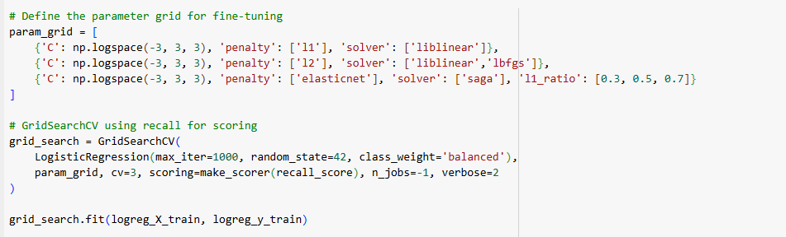
Logistics Regression (Fine-tuning)
GridSearchCV will be used for Logistic Regression to search for all hyperparameter combinations for better accuracy.
Best Parameters for Logistic Regression: {'C': 0.001, 'penalty': 'l1', 'solver': 'liblinear'}

Slide 44
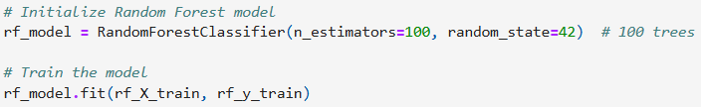
Random Forest
Random Forest fits a number of decision tree classifiers based on different sub-samples of the database and uses averaging to improve predictive accuracy and control over-fitting .
Implementation:

Slide 45
Why Random Forest?
Handles Complex relationship in customer Data
Banking dataset contains multiple interacting features. RF automatically captures these non-linear interactions.
Works well with categorical and continuous features
Bank dataset contains categorical and continuous features. RF does not require manual transformation or one-hot encoding as it can handle mixed type natively.
Less insensitive to imbalance data than other models
class_weight = ‘balanced’ forces the model to focus on minority class

Slide 46
Random Forest Struggles with Imbalance Dataset
Random Forest splits data based on majority class distributions. It relies on random sampling with replacement to train each tree (bootstrapping). Then it uses majority voting to make predictions.
Why that can be a problem when we have imbalance dataset:
It is biased to majority class.
Splits are influenced by the majority class, in our case “No”
Bootstrapping weakens minority class.
Minority class might not appear in enough trees
Majority voting overwhelms the minority prediction.
Since RF is biased towards majority class, their votes will favor “No”

Slide 47
Hyperparameter Tuning for Random Forest
n_estimator: Number of trees, the more trees there are the model can capture more complex relationships
max_depth: Depth of trees, prevents overfitting keeps pattern meaningful
Min_sample_split: Ensure balance split, prevents tiny group from overfitting
min_sample_leaf: Helps generalisation, avoid split based on very few customer
class_weight: prevents model from favouring “no”, improving recall

Slide 48
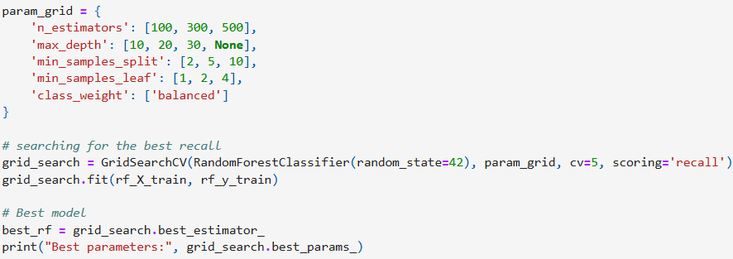
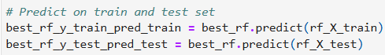
Random Forest (Fine-Tuning)
Best parameters: {'class_weight': 'balanced', 'max_depth': 10, 'min_samples_leaf': 4, 'min_samples_split': 2, 'n_estimators': 100}

Slide 49
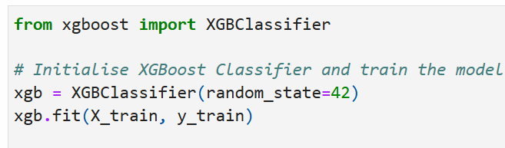
XGBoost Classifier
Extreme Gradient Boosting (XGBoost) is an optimized gradient boosting algorithm. It is well known for its superior performance in classification and regression tasks on structured data due to its speed and efficiency.
Implementation:

Slide 50
Why XGBoost Classifier?
Provides feature importance for explainability
Helps identify key drivers of customer engagement, which is crucial for banks to make data-driven marketing decisions
Optimised for imbalance datasets
XGBoost allows weighted class balancing (scale_pos_weight) to adjust for imbalanced class distribution of banking dataset
Faster Training Speed with Parallel Computing
Optimised for parallel processing and distributed computing, which allows faster training than traditional boosting algorithms.

Slide 51
Hyperparameter Tuning for XGBoost Classifier
n_estimator: Number of trees, the more trees there are the model can capture more complex relationships
max_depth: Depth of trees, prevents overfitting keeps pattern meaningful
learning_rate: Controls contribution of each tree to predictions, prevents overfitting
gamma: Split nodes based on loss reduction, prevents unnecessary splits
lambda: L2 Regularisation, control model’s complexity
alpha: L1 Regularisation, remove irrelevant features while keeping important predictors
subsample: Row sampling of tree, control how much data is randomly sampled per boosting iteration
min_child_weight: Min sum of instance weight, determine the minimum sum of sample weight needed to
create new node.
scale_pos_weight: Class weight balancing, adjust weight of minority class

Slide 52
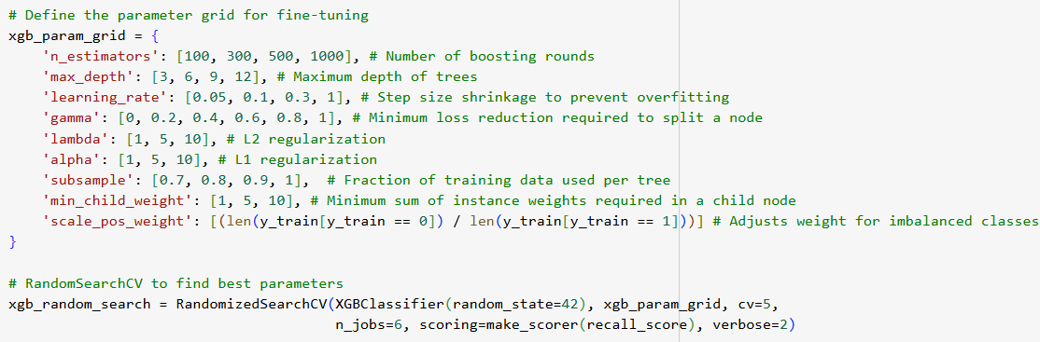
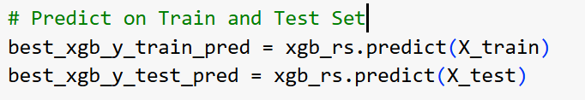
XGBoost Classifier (Fine-tuning)
Random Search CV will be used for for XGBoost instead of GridSearchCV to reduce runtime.
Key parameters tuned are defined in the code snippets below
Best XGBoost Classifier Model Parameters Found:
{'subsample': 0.9, 'scale_pos_weight': 7.876616379310345, 'n_estimators': 300, 'min_child_weight': 5, 'max_depth': 6, 'learning_rate': 0.05, 'lambda': 10, 'gamma': 0.2, 'alpha': 5}

Slide 53
05
Training
Results

Slide 54
Metrics
Objective: Determine whether a client will subscribe to a term deposit (y) based on data from a Portuguese bank.
Understanding Key Metrics in Model Evaluation:
Accuracy: Measures the overall correctness of the models
Not always reliable for imbalance datasets
Might be high even if the model failed to predict the minority class correctly
Precision: Measures how many of predicted positive cases are actually correct
High precision means fewer false positives
Useful when cost of misclassifying a non-subscriber as a subscriber is high
Recall: Measures how many actual subscribers are correctly predicted
Critical for our application as it helps identify potential customers, thus maximizing customer engagement and marketing effectiveness
F1-Score: The harmonic mean of precision and recall, balancing both metrics
Useful when we need a trade-off between precision and recall.

Slide 55
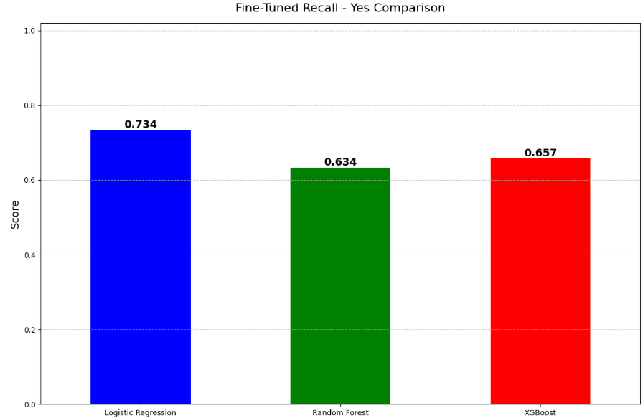
Model Comparison
Recall (y = yes) for Fine-Tuned Models
Highest Recall: Logistic Regression
Why?
Uses probability distributions rather than hard splits
Less biased towards class imbalance compared to tree-based models

Slide 56
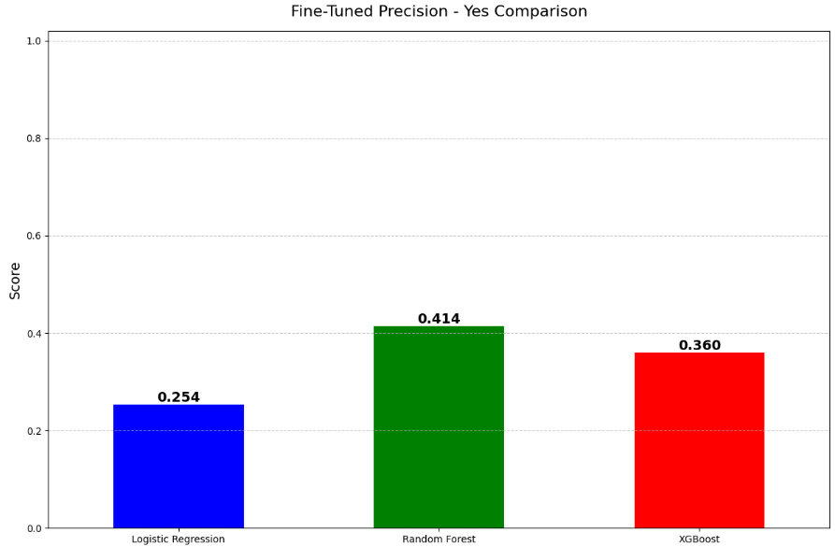
Model Comparison
Precision (y = yes) for Fine-Tuned Models
Highest Precision: Random Forest

Slide 57
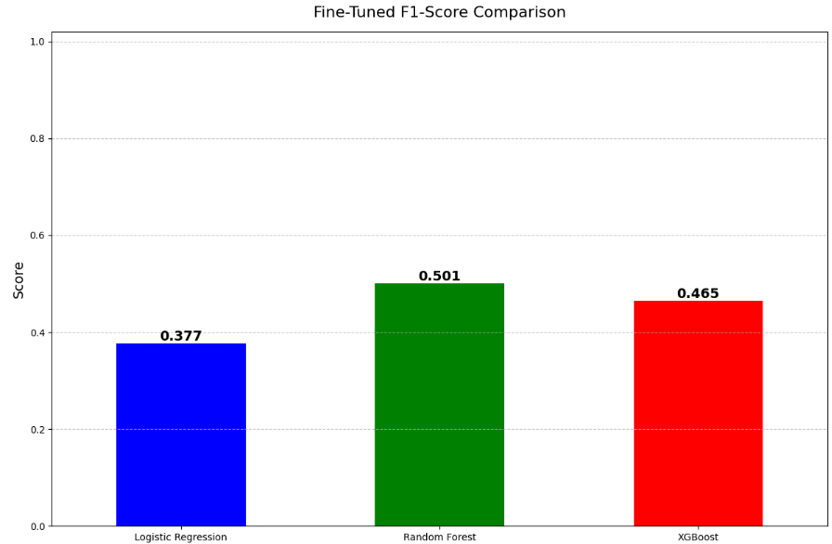
Model Comparison
F1-Score (y = yes) for Fine-Tuned Models
Highest F1-Score: Random Forest

Slide 58
Model Choice
 | Recall | Precision | F1-Score
Logistic Regression | 0.734 | 0.254 | 0.377
Random Forest | 0.634 | 0.414 | 0.501
XGBoost | 0.657 | 0.360 | 0.465
Metrics
Model
No. | Business Scenario | Key Metric | Best Model
1 | Bank does not want to miss any potential subscribers Outreach cost & effort is low | Recall | Logistic Regression
2 | Outreach cost & effort is high Bank wants to minimise cost & wasted effort | Precision | Random Forest
3 | Bank wants to balance between Scenarios 1 & 2 | F1-Score | Random Forest

Slide 59
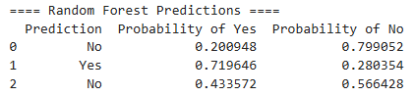
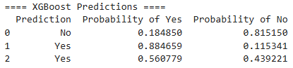

Manual Data Testing
Sample Customer Profiles for Testing
Manual testing with 3 profiles: young, middle-aged, and senior.
14-year-old predicted "No" across all models.
Older individuals show higher probability of "Yes."

Slide 60
Conclusion
Future Improvement
Class Imbalance
Use SMOTE (Synthetic Minority Over-sampling Technique) or ADASYN to balance the dataset and improve recall for the minority class.
Alternative Models & Techniques
Deep Learning: Implement Neural Networks (ANNs, CNNs, or RNNs) to uncover complex patterns in customer behavior.
Hyperparameter Tuning: Expand the search space for model parameters to improve performance across all models.

Slide 61
References
Hou, S. et al. (2021) 'Applying machine learning to the development of prediction models for bank deposit subscription,' International Journal of Business Analytics, 9(1), pp. 1–14. https://doi.org/10.4018/ijban.288514.
Haque, F.M.A. and Hassan, Md.M. (2024) 'Bank loan prediction using machine learning techniques,' arXiv (Cornell University)[Preprint]. https://doi.org/10.48550/arxiv.2410.08886.

Slide 62
Thank You

